Slide 1


Utilizing Polymer Composites Supported on Biochar for Wastewater Treatment
INTRODUCTION
Heavy metals, dyes, and other pollutants pose significant risks to ecosystems, water resources, and human health.
Developing effective remediation materials is therefore a critical research priority.
Among the tested materials, polymers are widely recognized for their efficiency in removing contaminants from aqueous solutions.
Biochar, a carbon-rich material produced from waste biomass such as food and plant residues, is a promising low-cost adsorbent.
Combining biochar with polymers to form composite materials offers enhanced adsorption properties, enabling more efficient removal of pollutants from water and wastewater.

Slide 2
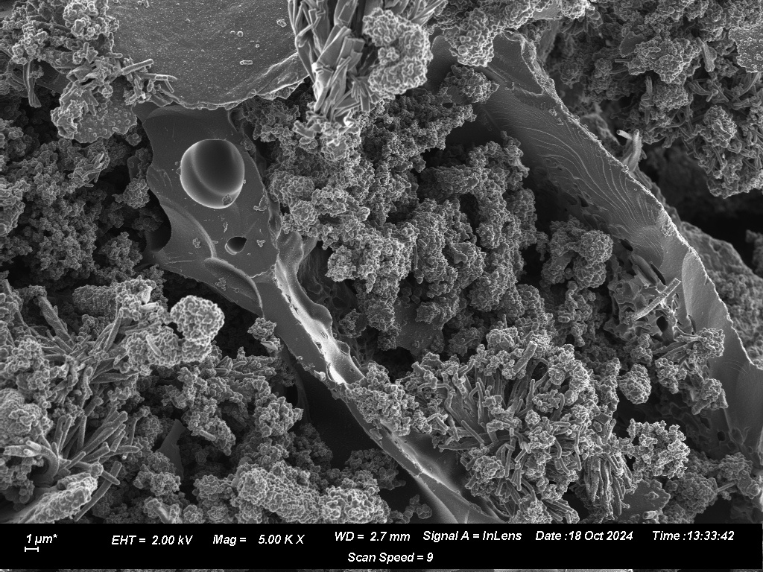
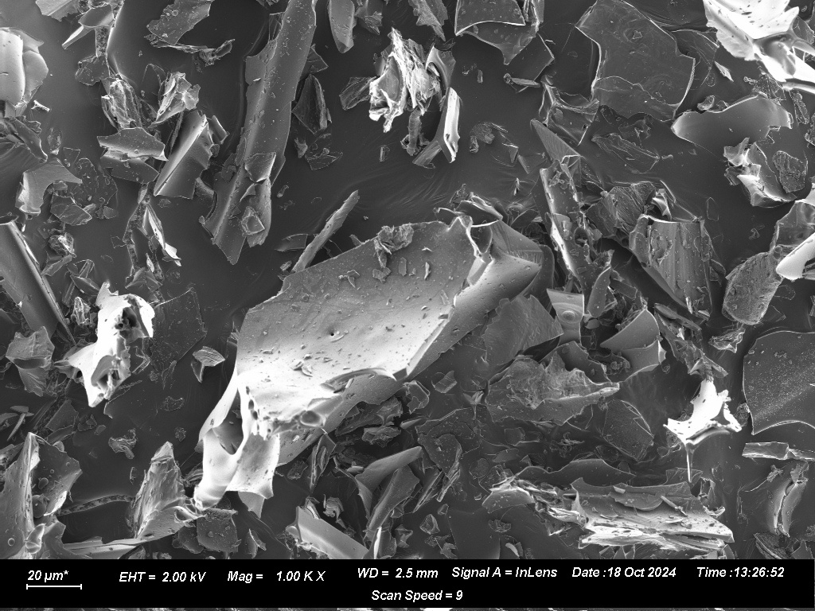
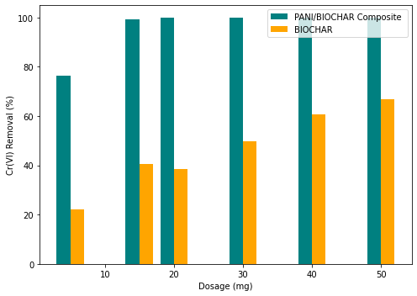
Utilizing Polymer Composites Supported on Biochar for Wastewater Treatment
OBJECTIVE
To improve the efficiency of water treatment processes by utilizing widely available food waste materials.
METHODOLOGY
RESULTS/FINDINGS
  Biochar from food/plant wastes
  Functionalization using polymer (polyaniline)
  Characterization of the synthesized materials (SEM, BET, XPS)
  Batch studies to test removal of pollutants under different parameters.
  Development and testing of continuous flow system

